Slide 1





Flight Status & Notification System
By Nitin Kumar
29.07.2024

Slide 2


1
Introduction
In today's fast-paced world, timely and accurate information about flight status is crucial for passengers and airport operations.
This project, titled "Flight Status and Notifications System", aims to address this need by providing a comprehensive solution that offers real-time updates on flight status, including delays, cancellations, and gate changes, along with push notifications to keep passengers informed.

Slide 3
2
Purpose and Objectives
Push Notifications: Implement a robust notification system to send alerts via SMS and email, informing passengers of any changes to their flight status.
User-Friendly Interface: Develop an intuitive and responsive front-end using React.js to present flight information easily.
Reliable Backend: Utilize Python and Flask to handle data processing and API requests, ensuring smooth communication between the frontend and backend systems.
Mock Data Implementation: Since real-time data integration wasn't feasible, we used hardcoded data to simulate real-world scenarios, ensuring the system functions correctly under test conditions.

Slide 4

3
Technologies Used
React.js: Utilized to build a dynamic and responsive user interface, allowing users to access flight status information easily.
Other Libraries: Incorporated various libraries like TailwindCSS, Axios, DaisyUI, etc. to enhance the functionality and user experience of the front-end application.
FRONTEND

Slide 5
4
Technologies Used
Python & Flask: Employed Flask, a lightweight web framework, to handle server-side logic, API endpoints, and communication with the front end.
BACKEND

Slide 6
5
Technologies Used
MongoDB: Used as the database to store flight data. Data is fetched from MongoDB and passed to the front end for display, ensuring users have access to the most recent information.
Database

Slide 7
6
Technologies Used
Email Notifications: Implemented using the smtplib library to send email alerts to passengers regarding changes in their flight status.
SMS Notifications: Leveraged Twilio to send SMS notifications, keeping passengers informed via text messages.
Notifications

Slide 8
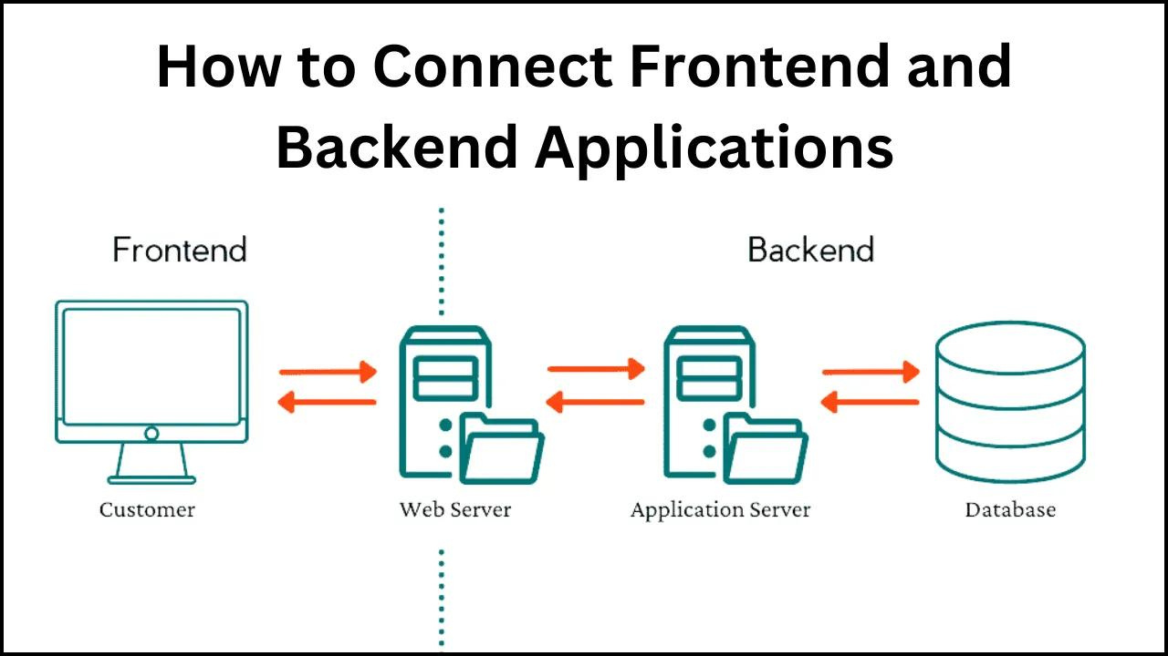
7
System Architecture

Slide 9
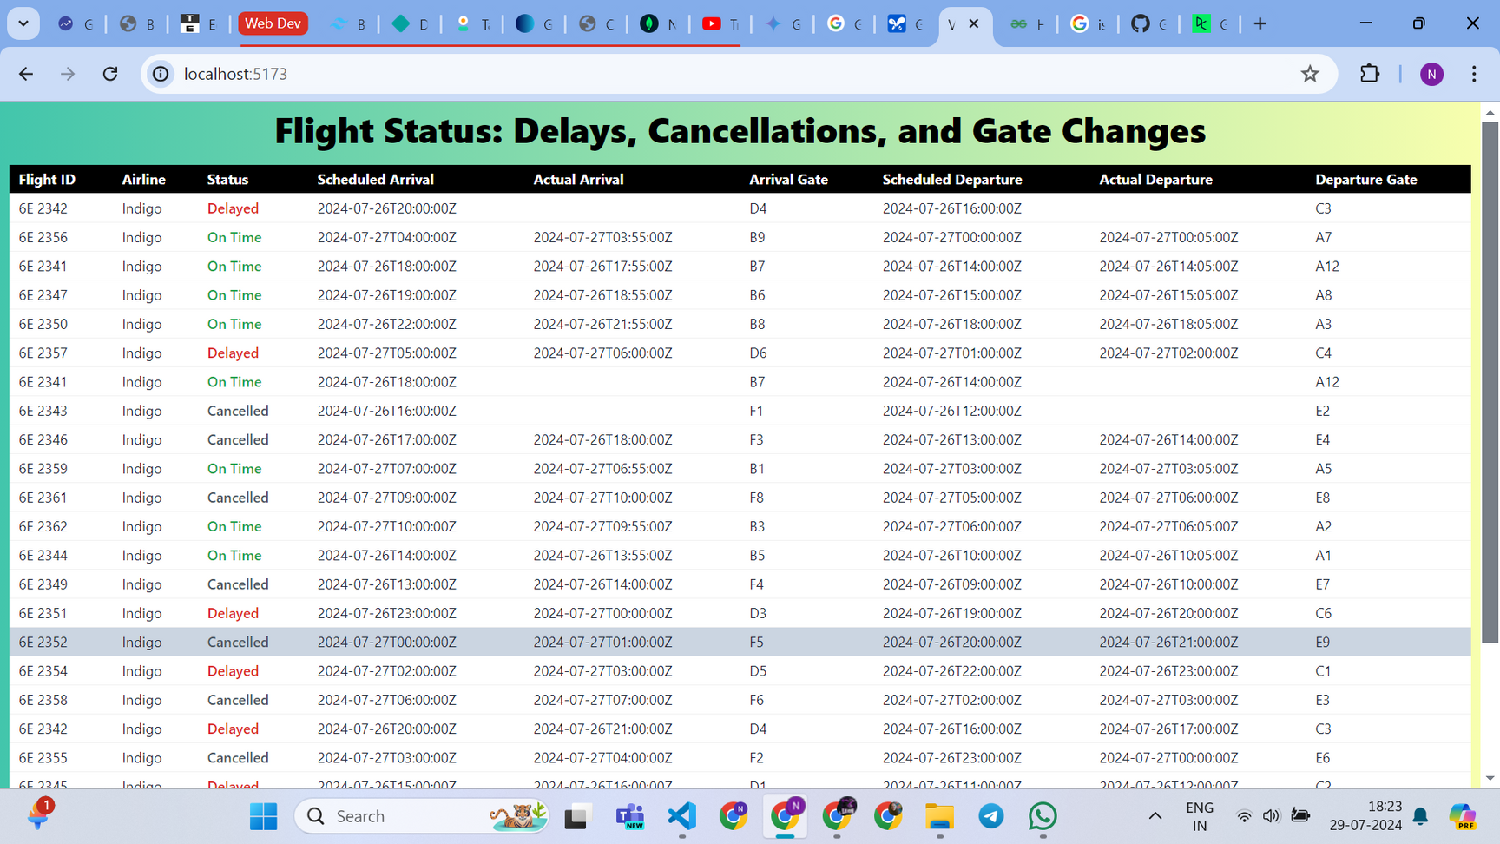
8
Frontend Implementation

Slide 10
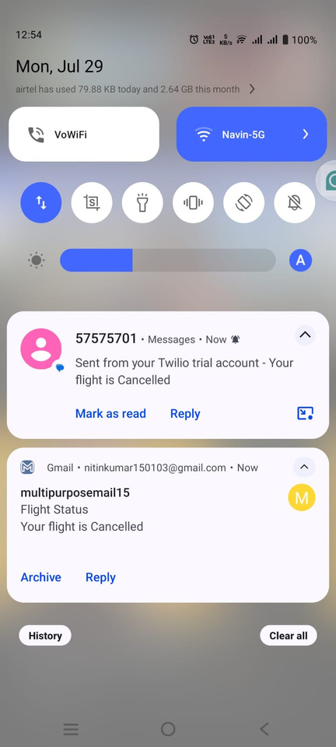
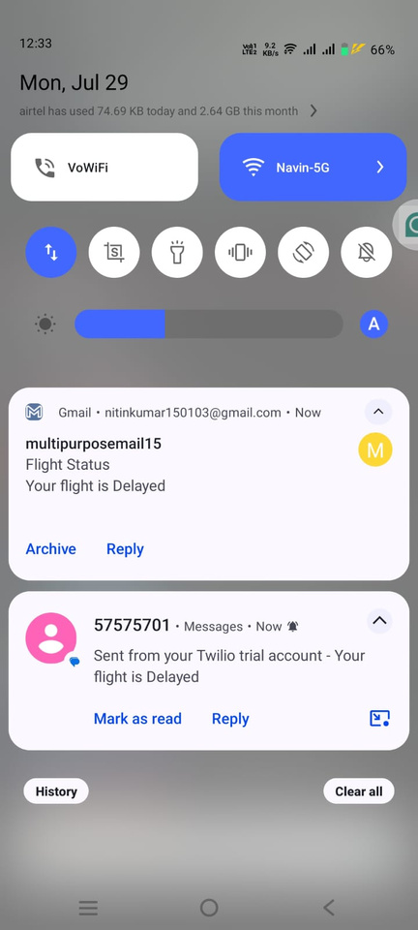
9
Notification System
Email notifications using smtplib
Setup and configuration
Example of email notification
SMS notifications using Twilio
Setup and configuration
Example of SMS notification

Slide 11

10
Data Handling
The effective management and processing of flight data are critical to the functionality of the Flight Status and Notifications System. Here's how data handling was implemented:
Hardcoded Data:
Initially, the system uses hardcoded flight data to simulate real-world scenarios.
This data includes flight IDs, airlines, status (on-time, delayed, canceled), departure and arrival gates, scheduled departure and arrival times, and actual departure and arrival times.

Slide 12
11
Data Handling
[
{
"flight_id": "6E 2341",
"airline": "Indigo",
"status": "On Time",
"departure_gate": "A12",
"arrival_gate": "B7",
"scheduled_departure": "2024-07-26T14:00:00Z",
"scheduled_arrival": "2024-07-26T18:00:00Z",
"actual_departure": "2024-07-26T14:05:00Z",
"actual_arrival": "2024-07-26T17:55:00Z"
}
// Additional flight data entries...
]
[
{
"notification_id": "1",
"flight_id": "6E 2341",
"message": "Your flight is On Time.",
"timestamp": "2024-07-26T13:00:00Z",
"method": "SMS",
"recipient": "+1234567890"
}
// Additional notification data entries...
]

Slide 13
12
Data Handling
Data Storage:
MongoDB: Flight and notification data are stored in MongoDB, a NoSQL database that offers flexibility and scalability.
Schema Design: The database schema is designed to accommodate flight information and notifications efficiently.
Data Retrieval and Passing:
Backend to Frontend: Data is fetched from MongoDB using Python and Flask. The backend processes this data and passes it to the frontend, ensuring users always have access to the latest information.
API Endpoints: Created API endpoints to handle data requests from the frontend, ensuring seamless data flow between the client and server.

Slide 14

13
Conclusion
Project Summary: The Flight Status and Notifications System provides a comprehensive solution for real-time flight status updates and notifications. Despite the use of hardcoded data, the system demonstrates the potential for enhancing passenger experience through timely information and alerts.
Key Takeaways:
Leveraging modern web technologies (React.js, Python, Flask) and robust notification services (smtplib, Twilio) can create an efficient and user-friendly system.
Addressing challenges in real-time data integration and reliable notifications is crucial for system effectiveness.
Utilizing MongoDB for data storage ensures flexibility and scalability in handling flight and notification data.

Slide 15
14
Future Enhancements
Real-Time Data Integration: Incorporate real-time flight data sources for more accurate and dynamic updates.
Enhanced Notifications: Expand notification options to include push notifications via mobile apps.
Additional Features: Implement user-specific features such as flight tracking, weather updates, and more detailed flight information.

Slide 16

Thank You
Email: nitinkumar150103@gmail.com

